Slide 1
React -Redux

Slide 2
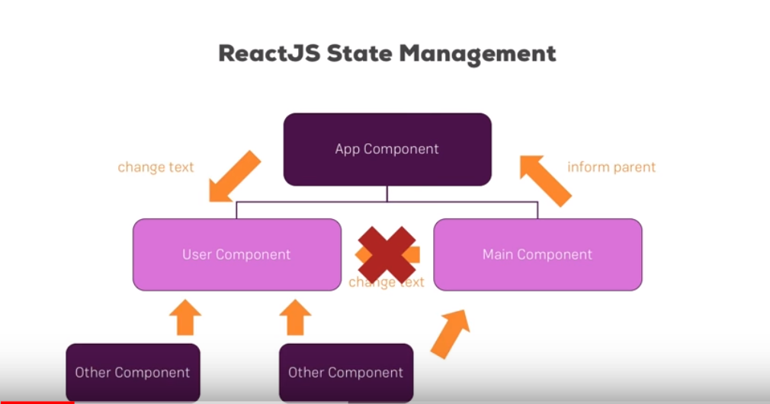

Slide 3
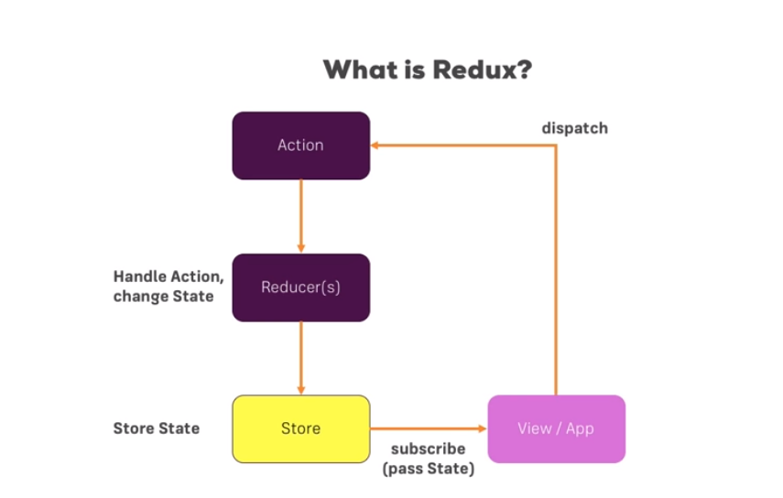

Slide 4
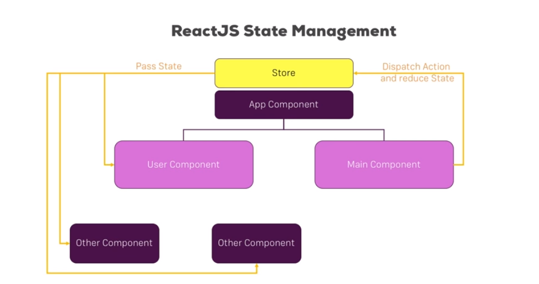
React-Redux

Slide 5
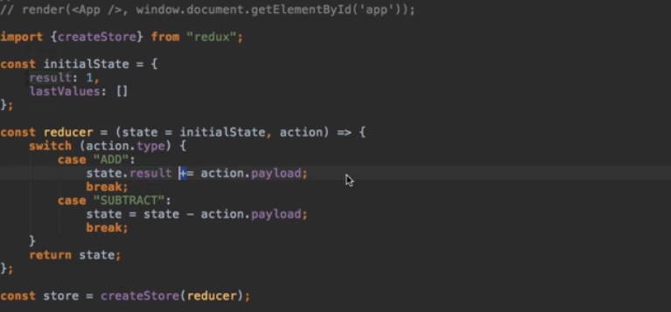
Change code for Initial State & RUN

Slide 6
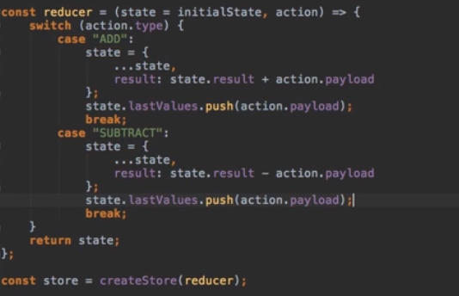
Push value in Array

Slide 7
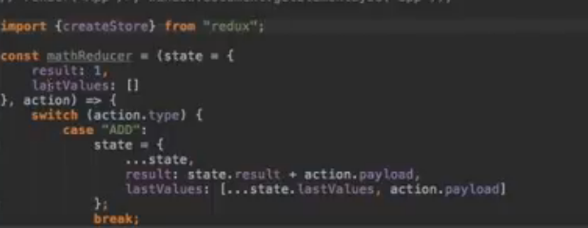
Combined Reducer
Put Initial State in reducer

Slide 8
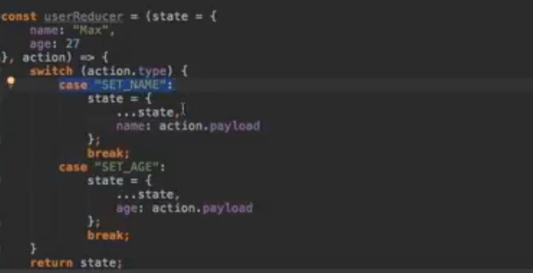
Create another Reducer :- ;

Slide 9
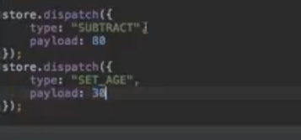
Import Combined Reducers
Out put with Combined reduced

Slide 10
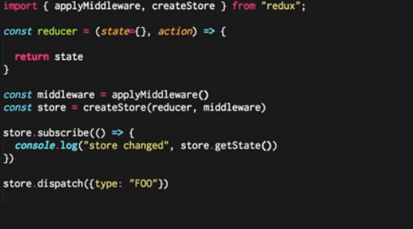
Basic Middle ware

Slide 11
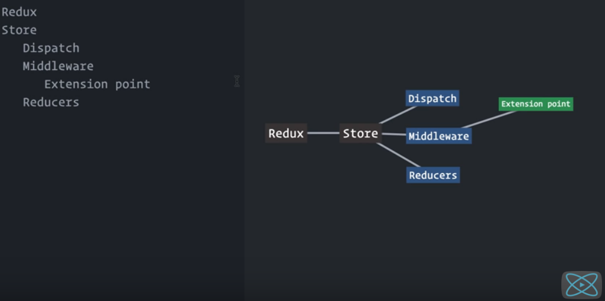
Redux Middleware

Slide 12
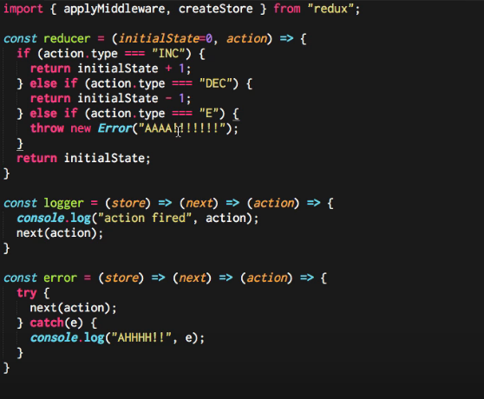
Apply Middleware in redux

Slide 13
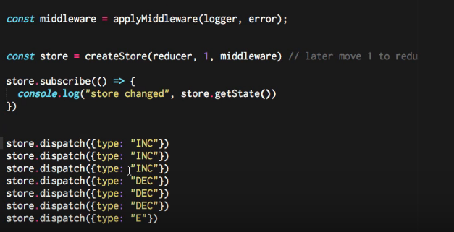
Client Code

Slide 14
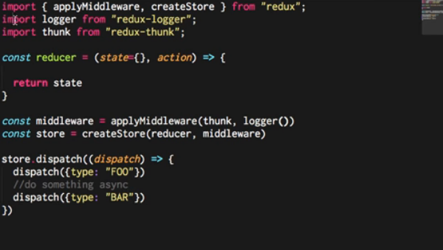
Multiple Action using Redux Thunk- Asyc

Slide 15
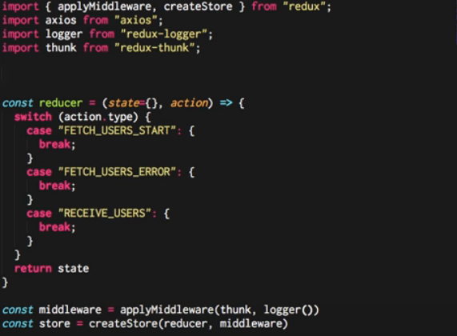
Complex Axios Call by Thunk

Slide 16
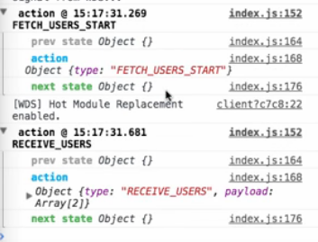
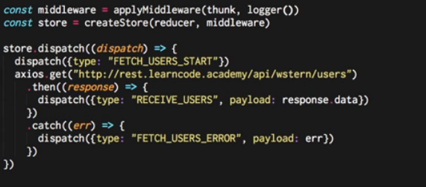
Add Method dispatch

